Slide 1
Primer on pThreads and its Programming
CS560: Advanced Operating Systems

Slide 2
Outline
Process
Threads
Threads implementation
Pthreads
Thread lifecycle
Thread Scheduling
Thread Synchronization

Slide 3
Process
A program in execution
System process: execute system code
User process: execute user code
Multitasking system allows multiple processes to be executed concurrently, with the CPU (or CPUs) multiplexed among them.
By switching the CPU between processes, the operating system can make the computer more productive.

Slide 4
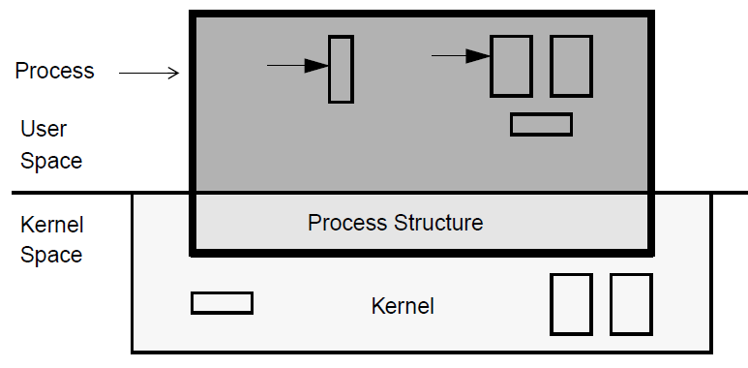
User process
A heavy-weight, kernel-level entity that includes CPU state (i.e. registers), memory, OS information (such as open files, a process ID).
Stack pointer
Program counter
Memory layout for multitasking system

Slide 5
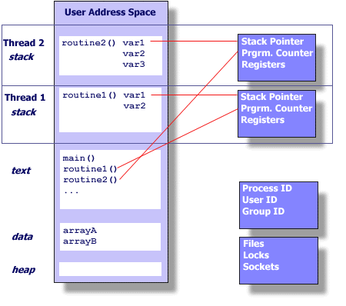
Process and Threads
UNIX PROCESS
THREADS WITHIN A UNIX PROCESS

Slide 6
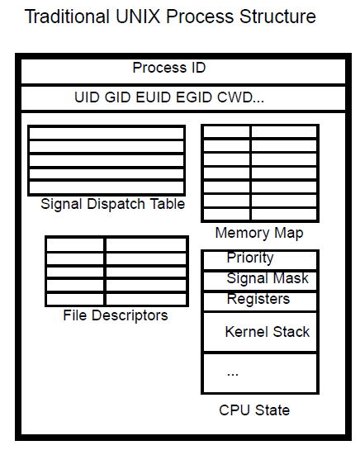
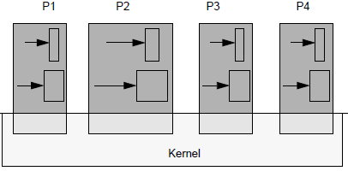
Process Structure
Processes
UID: user ID; GID: group ID;EUID: effective UID; EGID: effective GID;
CWD: current working directory

Slide 7
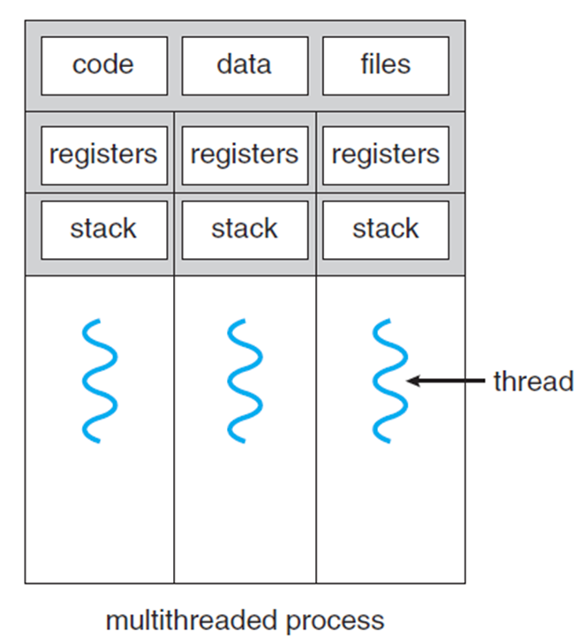
Thread
Thread is a light-weight entity. Each is a unit of execution consisting of a stack and CPU state (i.e. registers) and some other data.
Shared
Threads in the same process share the same address space, process structure.
Processes communicate through OS, while threads in a process communicate through memory.

Slide 8
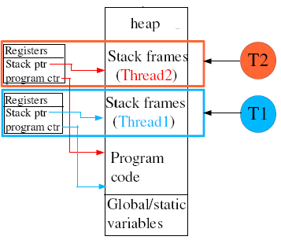
Shared address

Slide 9
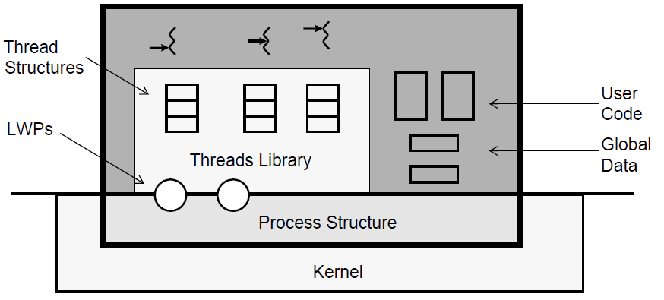
Thread structure

Slide 10
LWP
LWP: Lightweight process. It is an implementation technique for providing kernel-level concurrency and parallelism to support the threads interface. LWP can be thought of as a virtual CPU to be scheduled by the kernel to execute code. It can perform independent system call.

Slide 11
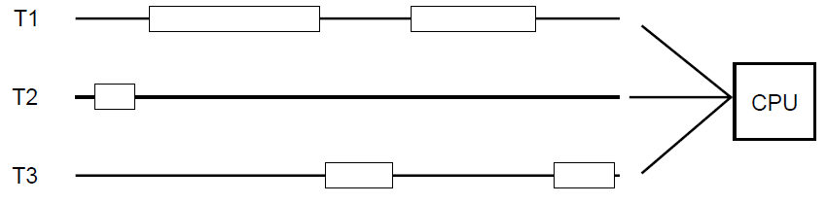
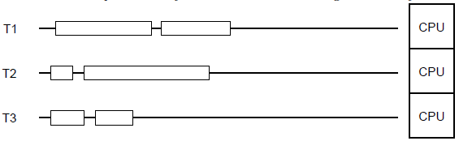
Concurrency vs. Parallelism
Concurrent execution on a single-core system
Parallel execution on a multi-core system

Slide 12
Advantages of Threads
Parallelism
Threads can be run in parallel on multiprocessor.
Responsiveness
Program continues running when part of it is blocked or is performing a lengthy operation.
Communications
Different threads share the same address space.
System resources
Why don’t use multiprocesses with shared memory?
Debugging is tough.
Things take longer.
Processes use lots of kernel memory.

Slide 13
What programs to thread?
Inherently MT programs
- Independent task
- Servers
- Repetitive tasks
Not obviously MT programs
- Numerical programs
- Old code
Programs not to thread
Programs requires separate processes
Programs that need to control its global environment closely.
Programs that run fast enough without inherent multitasking (i.e. icon editor or calculator application)

Slide 14
Thread Implementation
Thread library
Provides the programmers with an API for creating and managing threads.
Two ways to implement
 | User-level library | Kernel-level library
Location of data structures and code | user space | kernel space
Library calls | local function calls | system calls

Slide 15
Three main thread libraries
POSIX Pthreads
Provided as either a user-level or kernel-level library
Windows thread library
Kernel-level library available on Windows systems
Java thread library
Allows threads to be created and managed directly in Java programs
JVM: on Windows systems – Windows API
Unix and Linux systems - pthreads

Slide 16
Pthreads
POSIX threads are implementations adhering POSIX standard (IEEE 1003.1c - 1995) defining an API for thread creation and synchronization.
Systems implementing this API are mostly UNIX-type systems: Linux, Mac OS X, and Solaris, NetBSD, FreeBSD.
Pthreads are defined as a set of C programming language types, functions and constants. It is implemented with a pthread.h header and a thread library.

Slide 17
Lifecycle
The APIs involves the threads’ lifecycle
pthread_create()
pthread_exit()
pthread_join()
pthread_cancel()

Slide 18
pthread_create()
Call the create function pthread_create(thread, attr, start_routine, arg)
Call exit function pthread_exit(status)
No parent / child relationship between creator and createe

Slide 19

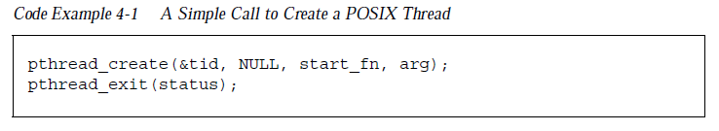
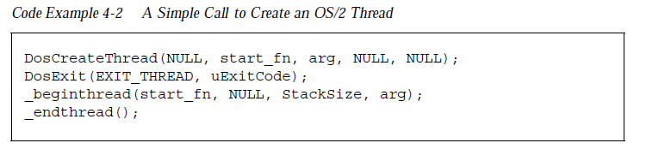
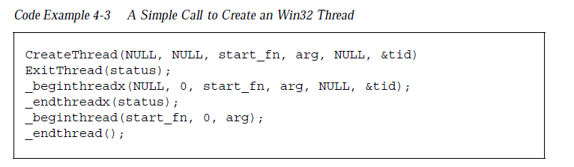
pthread_create() – Cont.

Slide 20
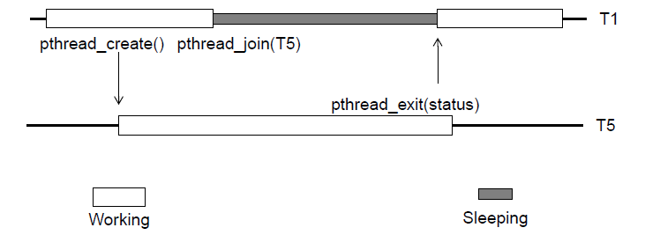
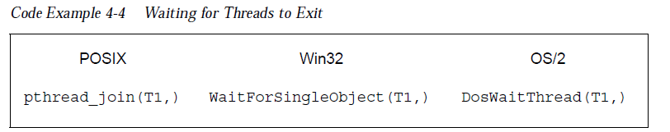
pthread_join()
A thread will go to sleep if it called pthread_join() and that thread is still running

Slide 21
pthread_join() – Cont.
Not all pthreads can be joined.
Detached thread: Intent not to join a thread. If you try to join a detached thread, you will get an error
Joinable thread: Can be joined. If you forget to join a nondetached thread, it will become a zombie
int pthread_attr_setdetachstate(pthread_attr_t *attr, int detachstate);
int pthread_attr_getdetachstate(pthread_attr_t *attr, int *detachstate);
int pthread_detach(pthread_t thread);

Slide 22
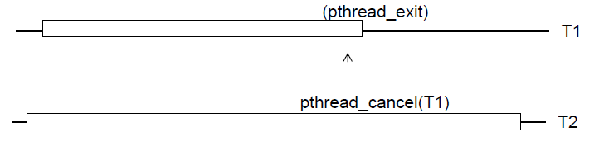
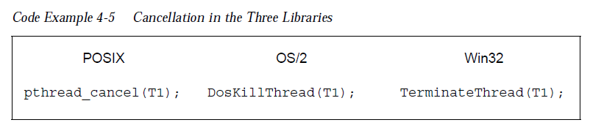
pthread_cancel()
Send a cancellation request to a thread and let it exit

Slide 23
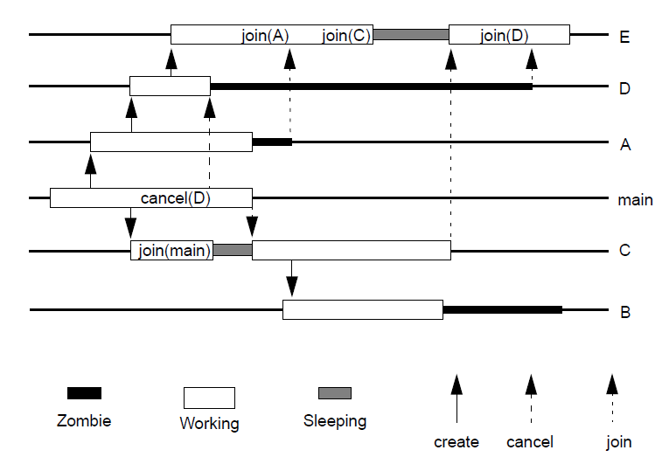
A comprehensive example
Join without sleep
Remain zombie until be joined
Receive cancel signal and become zombie
Join cause sleep

Slide 24
Running Demo

Slide 25
Two types of thread scheduling
Scheduling
Process Contention Scope (PCS): Thread library have full control
System Contention Scope (SCS): Scheduling is done by the kernel
POSIX | OS/2 | Win32
Allow Both | Only global scheduling | Only global scheduling

Slide 26
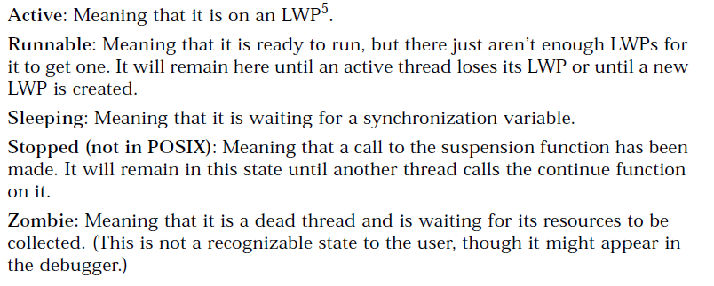
Thread Status

Slide 27
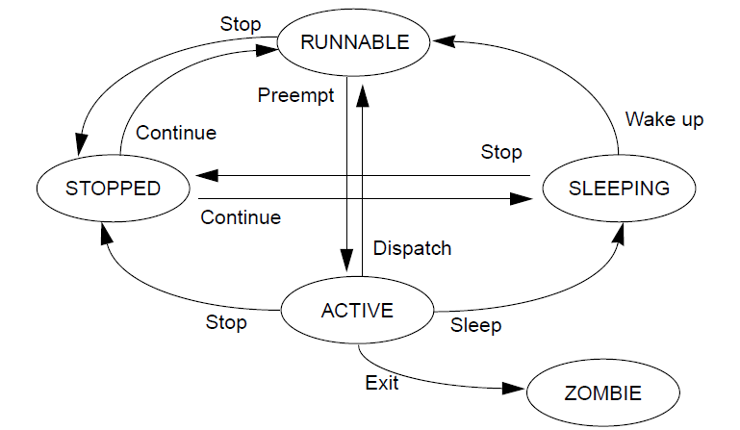
Thread Status Transition
Resource available
Wait for a lock, or get kicked off

Slide 28
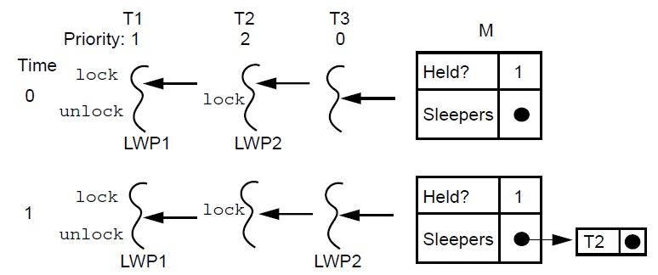
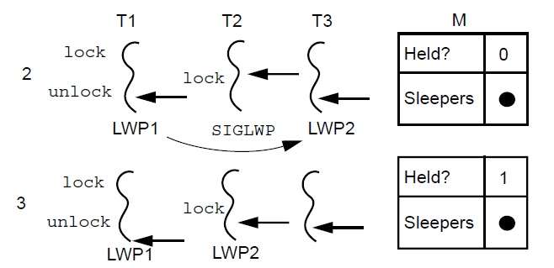
Context Switching
Preemption is the process of rudely kicking a thread off its LWP (or an LWP off its CPU) so that some other thread can run instead.
Preemption
2?

Slide 29
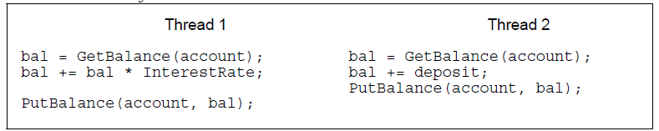

Synchronization
What would happen without synchronization?
?
What’s the value of “bal”
Overwrite data
Race Condition!

Slide 30
Critique Section
A critical section is a section of code that must be allowed to complete atomically with no interruption that affects its completion.
--Take your time, one by one
The thread that is executing in the critical section may even lose its processor, but no other thread may enter the critical section.
--Would rather waste than share

Slide 31
Critique Section
int pthread_mutex_lock(pthread_mutex_t *mutex);
int pthread_mutex_trylock(pthread_mutex_t *mutex);
int pthread_mutex_unlock(pthread_mutex_t *mutex);

Slide 32
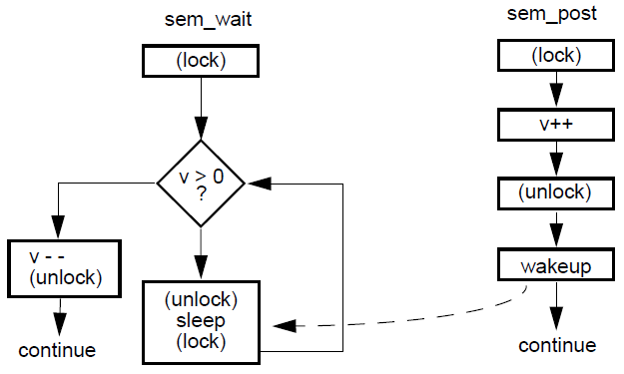
Semaphores

Slide 33
Semaphores – API
int sem_post(sem_t *sem) ;
int sem_wait(sem_t *sem) ;
int sem_getvalue(sem_t *sem, int *sval);
int sem_init(sem_t *sem, int pshared,
unsigned int value);
int sem_destroy(sem_t *sem);

Slide 34
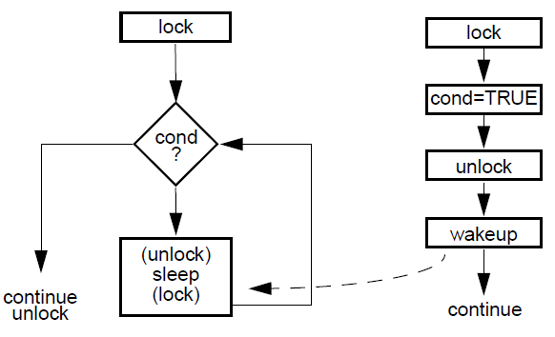
Condition Variables

Slide 35
Condition Variables – API
int pthread_cond_wait(pthread_cond_t *restrict cond,
pthread_mutex_t *restrict mutex);
int pthread_cond_signal(pthread_cond_t *cond);
int pthread_cond_timedwait(pthread_cond_t *restrict cond,
pthread_mutex_t *restrict mutex,
const struct timespec *restrict abstime);
int pthread_cond_broadcast(pthread_cond_t *cond);
pthread_cond_t cond = PTHREAD_COND_INITIALIZER;
int pthread_cond_init(pthread_cond_t *restrict cond,
const pthread_condattr_t *restrict attr);
int pthread_cond_destroy(pthread_cond_t *cond);

Slide 36
Comparison: Two examples
If you have a limited resource, say 10 pages of memory reserved for your threads, then you will need them to wait until a page is available. When this happens, you will need to let just one thread start execution. In this case you can use a semaphore unlock up as many threads as available pages.
-> Competing for limited resource
If all of your threads are waiting for some event, e.g., submission of a task, then you can wake them all up by using a condition variable upon an event.
-> Broadcast a event to many threads
These scenarios can be implemented vice versa, only less convenient
Explanation from Stackoverflow.com

Slide 37
Demo on Semaphore

Slide 38
Demo on Condition Variable

Slide 39
Summary
What is thread? Why we need it?
Share resource, work together, raise utilization
How does the thread work?
Create them, synchronize them, recycle them
How to make thread your helper instead of trouble maker?
Avoid race condition, don’t mess up, fast and correct

Slide 40
Thanks!

